Slide 1

Level: Advanced – session 8
Game Development with Unity
Omid Saadat

Slide 2
Optimization
Topics
  Mesh triangle count (3D games)
  Texture/Sprite size
  Texture pack
  Code optimization
    Do less In updates
    Instancing
    Object pool
    Avoid garbages
  Profiler
  Memory management

Slide 3
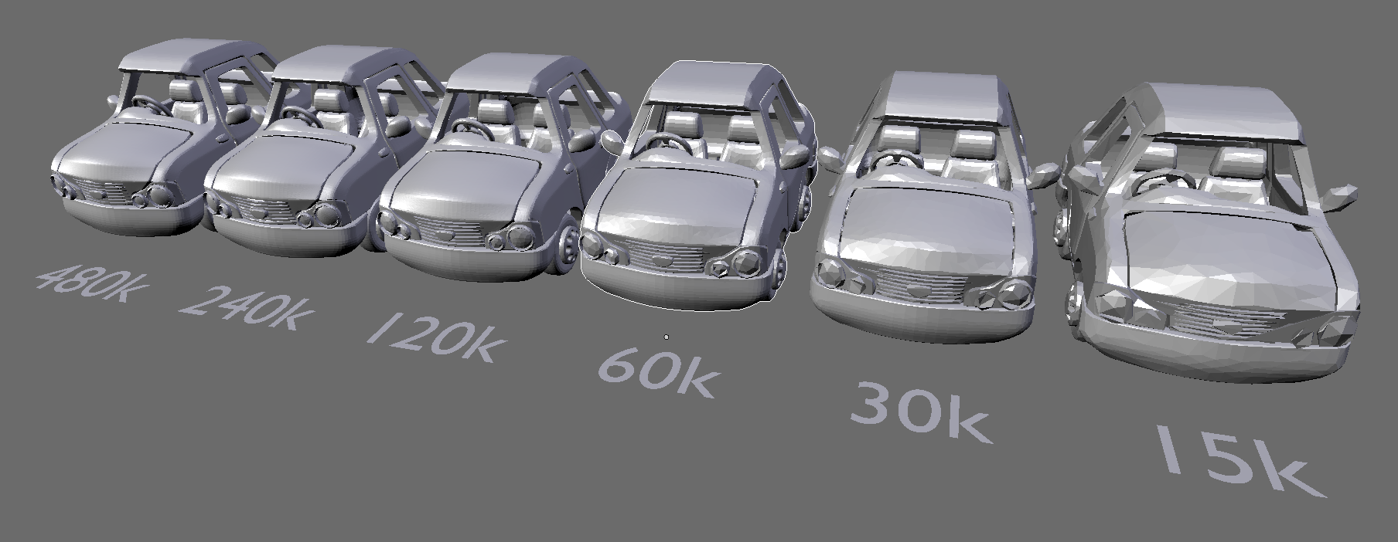
Mesh Triangle count
More Triangle => More data => More process => less performance

Slide 4
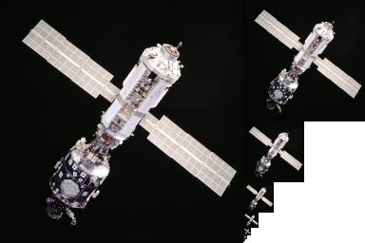
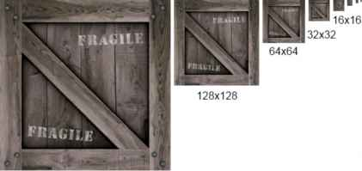
Texture/Sprite size
Bigger Texture => Eats more memory => less performance
What is mipmap

Slide 5
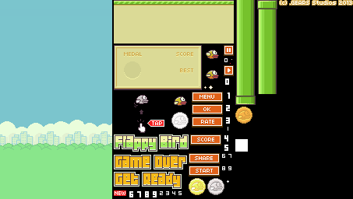
TexturePack
In unity:
  use “Packing tag”
  Import texture pack from outside!

Slide 6
Code Optimization
Do less In updates
Instancing: what happens when you use instance of an object instead of creating a new one?
Object pool:
  Destroy and recreate
  disable/enable and Re-Initialize
Avoid garbage
  Is everything I don’t need, completely destroyed and cleaned? (A texture pack of a scene with player texture packed inside!)

Slide 7
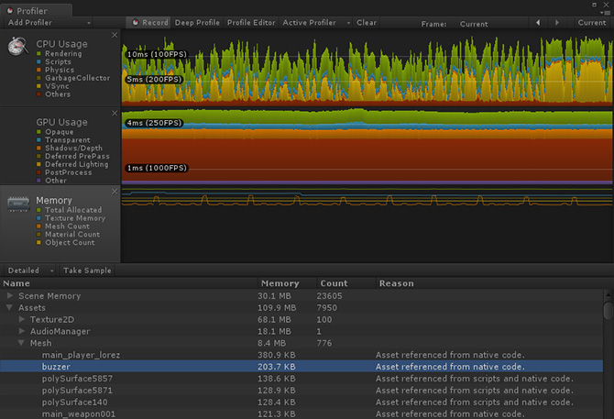
Profiler
Monitor your code/memory/cpu/gpu and etc in a professional way

Slide 8
Memory management
Consider everything I said at the same time.
  Minimum target memory
  What objects are currently in memory?
  Do I need them all?
  Can I reuse them?
  Coroutine, Boxing, function calls..
  What else makes garbage? Read this

